Slide 1
Developing and Extending the Blackbaud Data Warehouse
Jason Perry and Brad Gleich

Slide 2
Terminology
Data Mart
Structure that represents a single subject area (i.e. Revenue)
Data Warehouse
A SQL Server database containing multiple data marts
Cube
A SSAS database containing multiple data marts
BBDW
The whole solution including both the data warehouse and cube

Slide 3
Star Schema
100
Brad
Annual
$
Cash
May 31, 2013
Payment

Slide 4
Warehouse Advantages
Offline
Simple Structure
Pre-computed
Faster Reads

Slide 5
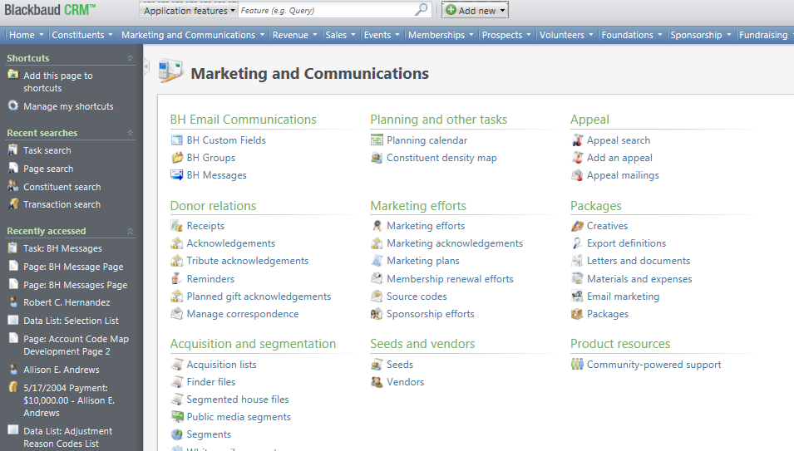
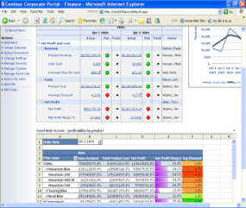
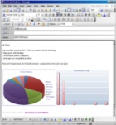
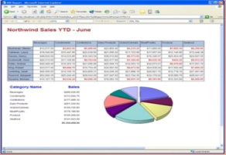
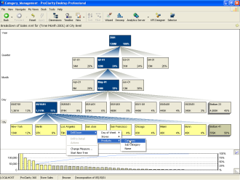
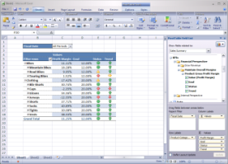
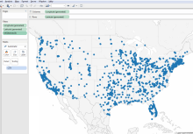
Architecture
BBCRM Transactional Database
Extensible ETL Packages
Blackbaud Data Warehouse
Query
Dashboards
BBCRM Data
ETL
Conformed Data
Source Data
Reports
Source Data
Analytics
Source Data
Excel
Other Data Warehouses

Slide 6
Data Coverage
Revenue
Constituent
Major Giving
Event
Interaction
Marketing
Relationship
Household
Campaign
Appeal
Constituency
Membership
Pledge
Recurring Gift
Education
Address
Sponsorship
Planned Gifts
Attributes
Smart Fields

Slide 7
Infinity and BBDW
Spec | Version | Notes
Report | 2.93
View Form | 2.94
Data List | 2.94 | Can also be used to drive UI Widgets
Query View | 2.94 | Non-root but can drive List Builders
Query View | 3.0 | Root queries including selections
Smart Query | 3.0
SQL Function | 3.0
SQL Stored Procedure | 3.0
SQL View | 3.0

Slide 8
CRM and BBDW
Ad-hoc Query
Constituent
Revenue
Revenue Recognition
Reports
Membership Activity
Giving List

Slide 9
Documentation
BBDW Documentation and How To Guides
Database Schema and Source/Target Mappings

Slide 10
Extend - Revisions
Use USP_DROPOBJECTIFEXISTS to remove invalid objects when revisions are run
Use USP_SCHEMA_TABLE_SETTABLECOMMENT to add a description to a table
Use USP_SCHEMA_TABLE_SETCOLUMNCOMMENT to add comments to table columns
MS_DESCRIPTION – Use this to define the source of the column. Use the format [schema].[table].[column]. The validation process uses this to verify the record types are compatible.
FK_REFERENCE – Use this to define referential column for the column. Use the format [schema].[table].[column]. At the end of the ETL a process will add an FK based on this comment.
INCLUDEINGRAIN – Use this to define the uniqueness for the table. The validation process uses this to verify that uniqueness of the rows in the table.
NULLABLE – Use this to designate columns that can contain null values. The validation process uses this to know not to check these columns for null values.
Use USP_SCHEMA_VIEW_SETVIEWCOMMENT to add a description to a view
Use USP_SCHEMA_VIEW_SETCOLUMNCOMMENT to add comments to view columns

Slide 11
Extend - SSIS
Try to use a pattern to develop new ETL packages. The BBDW_FACT_TEMPLATE and BBDW_DIM_TEMPLATE packages can used as templates.
Use CREATE_OR_DROP_INDICES to add or drop indices
@CREATE_OR_DROP
0 – Will drop all indexes that the procedure could have added (including columnstore).
1 – Will add indexes to the table. Will add non clustered indexes to SYSTEMID columns if they are of the data type UNIQUEIDENTIFIER and not the primary key.
@ADD_COLUMNSTORE
1 – If the @CREATE_OR_DROP is set to 1 as well it will create a non clustered columnstore index. This index will cover all supported data types based on SQL Server version.

Slide 12
Extend - SSIS
BBDW_DeletedIDTables_EXT.txt
The BBDW_DELETEDIDS package uses this file to how to handle deletes in the application database. The deployment will create new audit tables in the BBETLAUDIT schema in the application database to track deletions.
If you are doing a slowly changing dimension or historical table, you can choose not to use this process by not adding a row to this file.
BBDW_PackageList_EXT.txt
This file determines what 3rd party packages to run and in what order to run them. Add rows to this file for each package you want to run as part of the ETL.

Slide 13
Deployment
Run the deployment utility from the application database server as the Administrator
Advanced Options
Deploy OLAP cube – This option determines if the SSAS cube is deployed along with any features that rely on it (OLAP Explorer). Setting this option to false will cause the ETL to not process the cube.
Include Selections – This option determines if we should bring static selections from the application database into BBDW. Static selections made against BBDW will be created in both BBDW and the application database regardless.
Max ETL Parallelism – This option determines the max number of ETL packages we can run concurrently (1 – 4). This option only applies to the OOB packages.
Report database data path/Report database log path – Defines the location for the database data and log files to be created and stored. The default location is defined by SQL Server.
SSIS package root folder – Defines the location for all the files in the SSIS folder to be deployed. The default location is defined by SQL Server.
OLAP Extensions Path – Defines the location of the folder that contains the BBDW extensions. This location should have Revisions, SSIS, and UDM folders.

Slide 14
Query View
MartKey attribute needs to be set to BBDW in the root element.
Only set the IsRoot attribute in the root element to true if you want the query view to be the base of an ad-hoc query (e.g. Constituent, Revenue).
ViewSchema needs to be set to schema of where the view is to be created. This attribute is on the ViewImplementation element.
Use the Category attribute on the OutputField elements. This will allow for better organization of fields when using the query view in ad-hoc query.
Create a relationship to the Date dimension for each date field in the query view. This allows users to do interesting date things (e.g. trending).
The suite of BBDW queries include multiple versions of some query views. Make sure to check for all the places to relate custom query views.

Slide 15
List Builder
Uses a query view spec to create.
MartKey attribute needs to be set to BBDW in the root element.
Set the IsRoot attribute in the root element to False (this is the default value).
ViewSchema needs to be set to schema of where the view is to be created. This attribute is on the ViewImplementation element.
FunctionSchema needs to be set to schema of where the view is to be created. This attribute is on the TVFImplementation element.
Include the ListBuilder element at the end of the query view spec.
The order you list the columns in the ListBuilder/Columns element will decide the default column order.
Set a column’s IsDefaultColumn attribute to “true” to make it a default column.

Slide 16
{
}
Questions?

